Slide 1
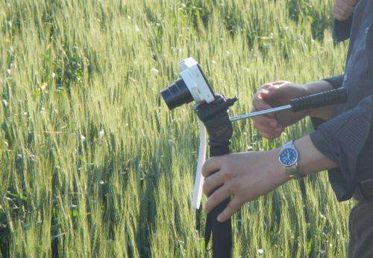
EARLY PEST DETECTION FROM CROP USING IMAGE PROCESSING AND COMPUTATIONAL INTELLIGENCE
BY:
AJMEERA YAKANNA(501)
S.ARUN KUMAR(552)
K.SWETHA(519)

Slide 2
ABSTRACT : Agriculture is an essential source of sustenance. In India, this sector has tremendous opportunities of large-scale employment for villagers. Here, agriculture consist of the composition of several crops depending on the climatic nature. Numerous heterogeneous diseases affect the production of crops and result as a profitable loss. The current method for the reduction of pest disease is to spray pesticides. However, this process severely affects the health of humans directly or indirectly. The image detection technique emerges as an effective measurement tool in order to fight the infestation. This technique offers better crop management with production as it delivers the maximum protection to crops.

Slide 3
EXISTING SYSTEM :
The backbone of the Indian economy is agriculture as over 70% population depends on it for their occupation.
Therefore, it becomes necessary to identify plant diseases in crops.
The composition of Indian agriculture including several crops such as wheat, rice, paddy, sugarcane, vegetables, pulses, fruits, etc. Indian farmers also produce many non-food items like rubber, cotton, bamboo, tea, coffee, etc.
There is a number of factors that develop different diseases in the roots and leaves of the plant that damaged crops and finally reduces crop production.
Several kinds of diseases reduce the plant growth rate or even depriving their existence.
Due to the lack of knowledge, farmers have difficulties to predict such diseases, especially at early stages.
The current method for the reduction of pest disease is to spray pesticides. However, this process severely affects the health of humans directly or indirectly.

Slide 4
DISADVANTAGES: 1.Time-consuming: Manual detection requires physically inspecting an area, which can take a lot of time depending on the size of the space. 2.Inefficiency: It can be difficult to detect pests manually, as they may be hiding in hard-to-reach areas or be difficult to spot. 3.Human error: There is always the possibility of human error when manually detecting pests, such as missing an infestation or misidentifying a pest. 4.Risk of exposure: Manual detection can put individuals at risk of exposure to pesticides, as well as the pests themselves. 5.Limited coverage: Manual detection is typically limited to a specific area and may not cover the entire property or facility.

Slide 5
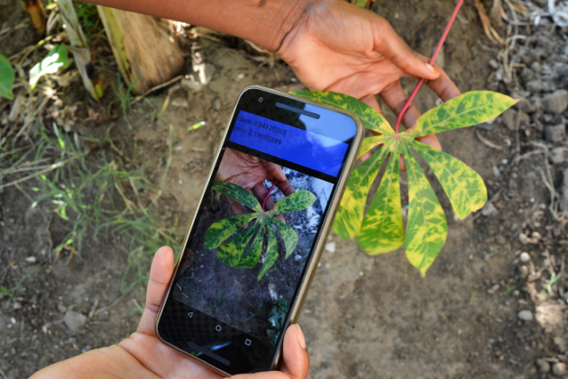
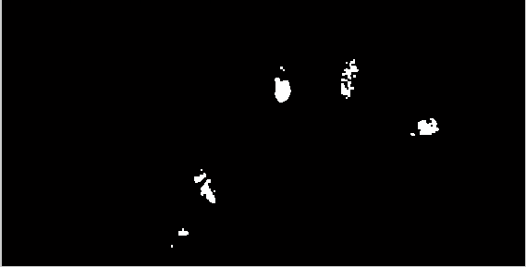
PROPOSED SYSTEM
Researchers could solve complex problems through image processing technology. It depicts the exponential growth of digital technology in the agricultural research field.
Insect pest detection automation has a realistic opportunity as image analysis.
Rice production increases (as both quality and quantity) by applying the right pests management and pest counting from the collected specimens through crop technicians.
It becomes easy to develop a highly efficient monitoring system through an automated system. Cameras can easily monitor and detect rice infestation.

Slide 6
ADVANTAGES: 1.Increased efficiency: image processing algorithms can quickly and accurately identify pests in images of crops, reducing the time and labor required for manual inspections. 2.Improved accuracy: computational intelligence techniques, such as machine learning, can learn to identify pests with high accuracy, reducing the risk of false positives or negatives. 3.Early detection: by identifying pests early, farmers can take action to prevent or control infestations before they cause significant damage to crops. 4.Reduced chemical use: early detection can also help farmers use pesticides more efficiently and effectively, reducing the overall amount of chemicals used on crops. 5.Better crop yield: by detecting and controlling pests early, farmers can increase crop yields, which can increase the profitability of their farms.

Slide 7
HARDWARE & SOFTWARE REQUIREMENTS: HARDware REQUIRMENTS : System : i3. Ram : 4 GB. Hard Disk : 40 GB SOFTWARE REQUIRMENTS : Operating system : Windows8. Coding Language : python.

Slide 8
CONCLUSION: In conclusion, early pest detection using image processing and computational intelligence is a promising approach for crop management. The use of image processing and computational intelligence techniques can enable farmers to quickly and accurately identify pests, allowing them to take action to prevent or control infestations before they cause significant damage to crops. This can lead to increased crop yields and reduced chemical use, which can improve the profitability and sustainability of crop production. However, it is important to be aware of the potential disadvantages of this technology, such as high cost, complexity, and limited applicability. Careful planning and implementation, as well as ongoing monitoring and evaluation, are essential for successfully utilizing image processing and computational intelligence for early pest detection.

Slide 9

ANY QUERIES ???

Slide 10
Thank you

